Slide 1

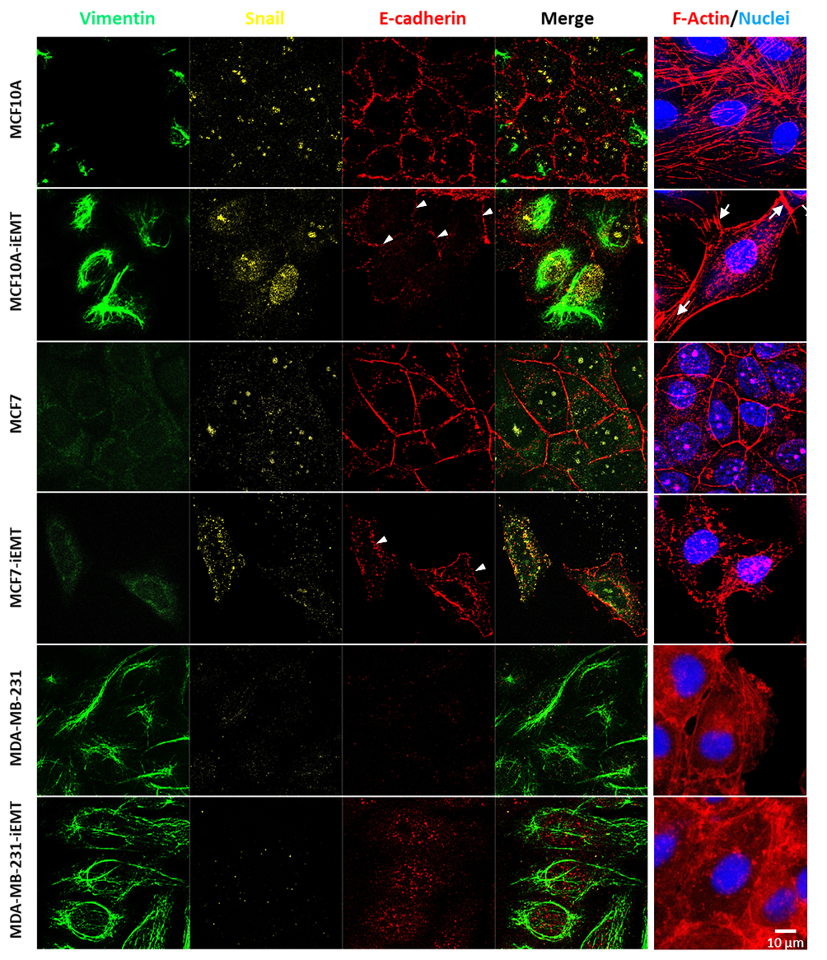
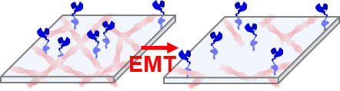
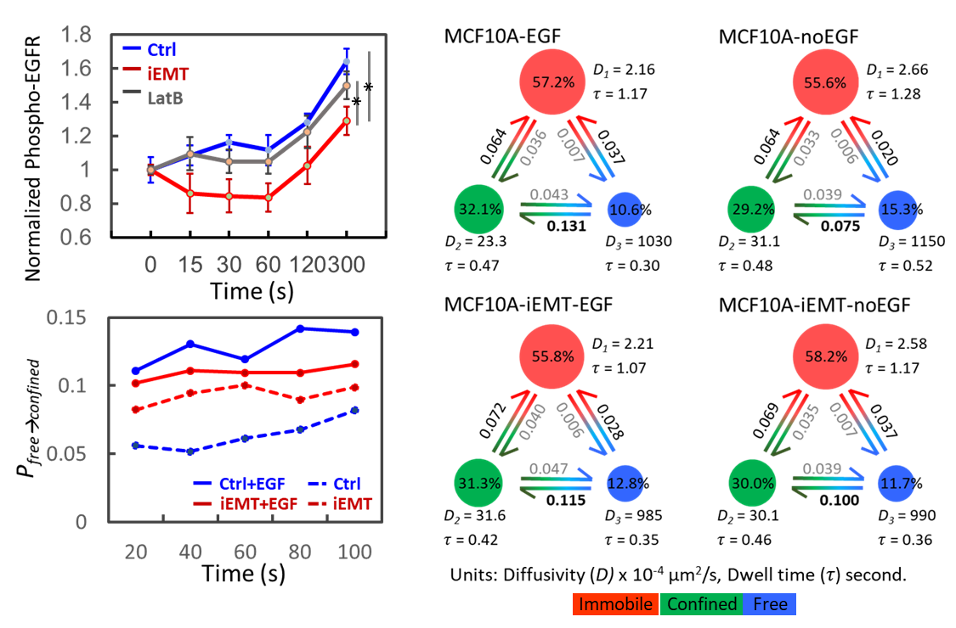
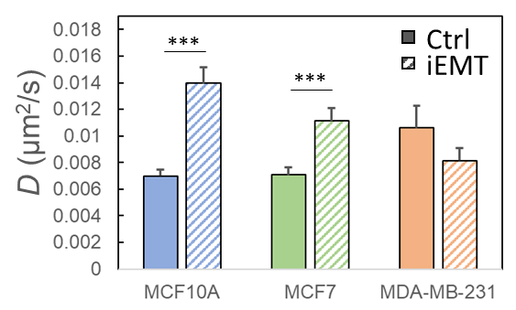
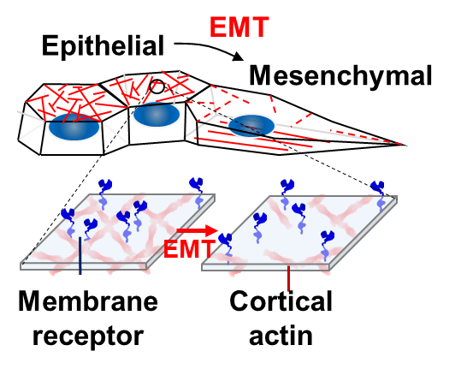
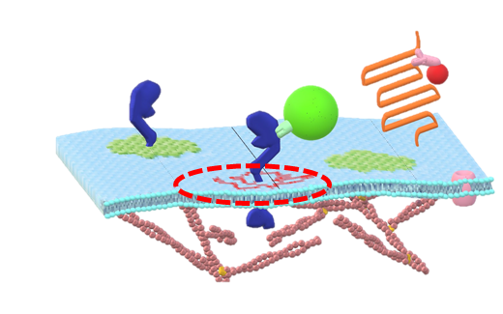
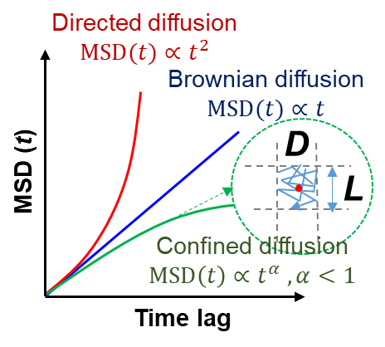
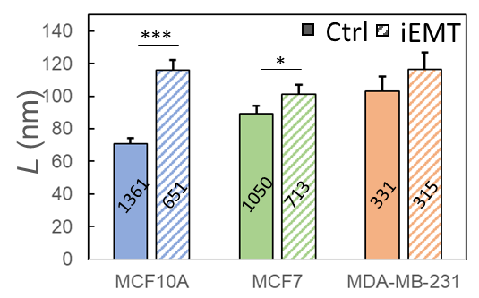
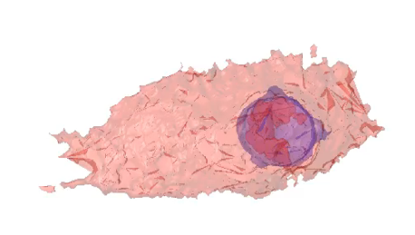
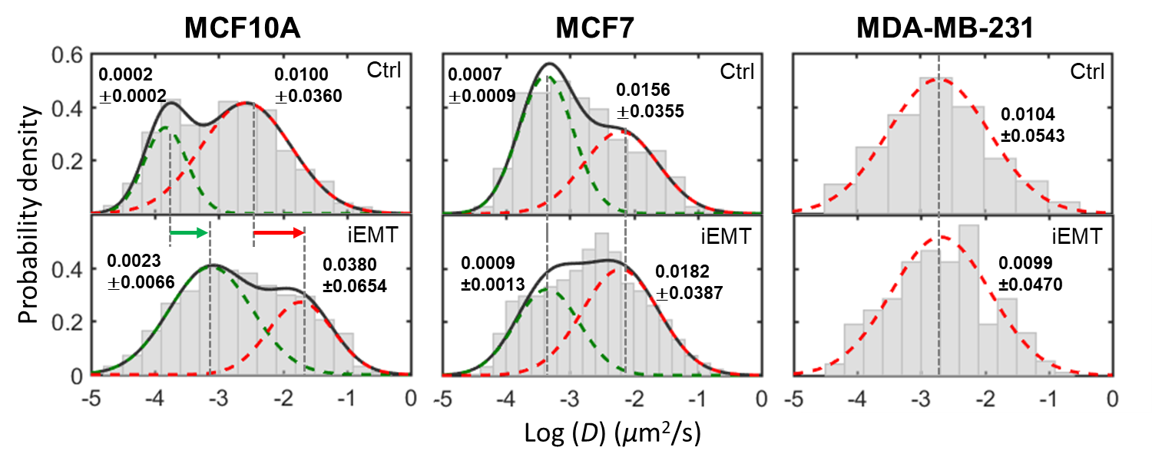
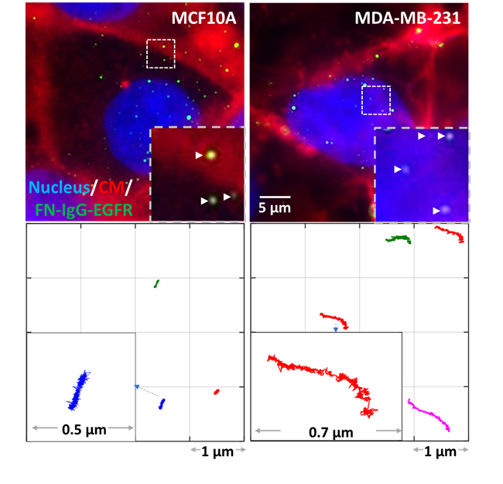
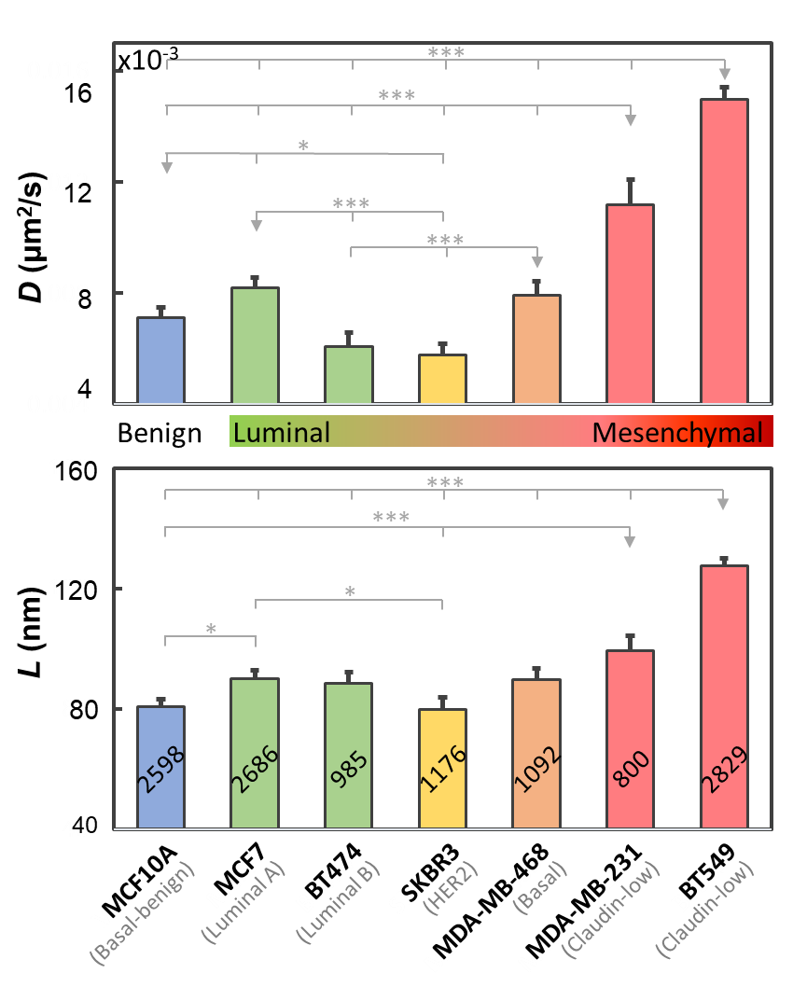
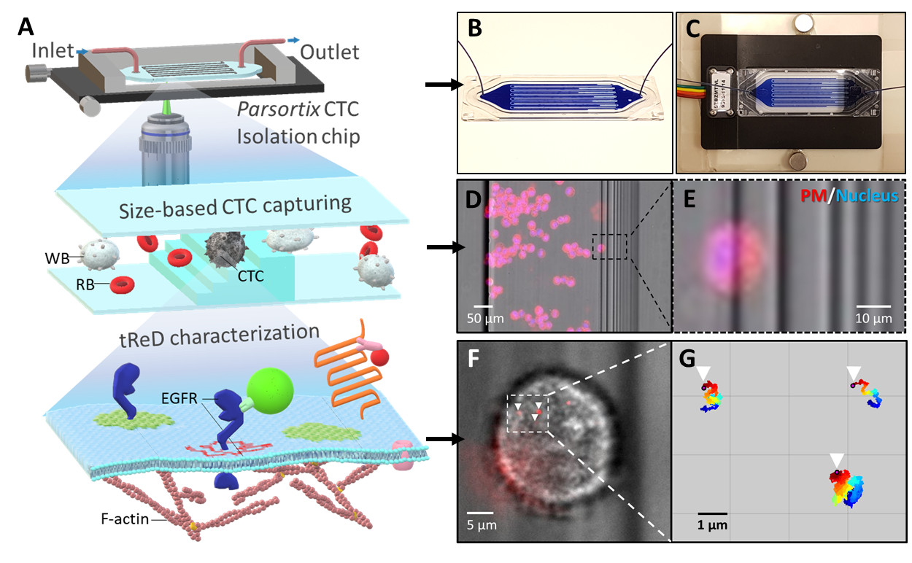
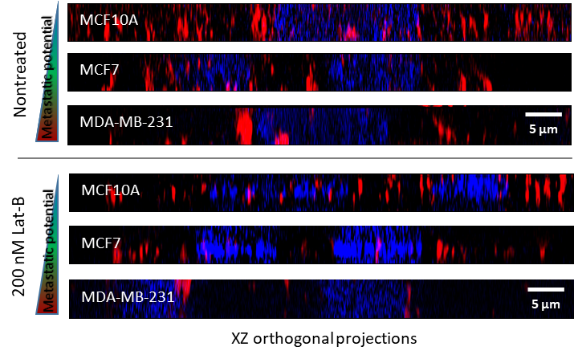
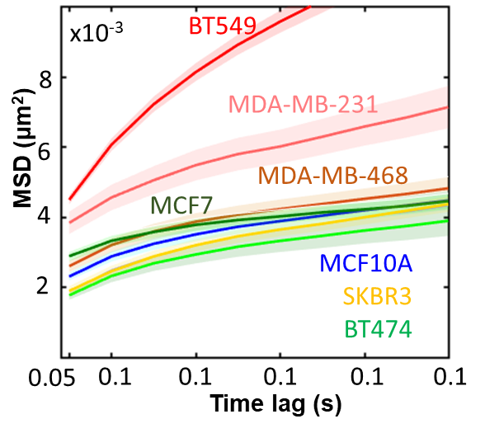
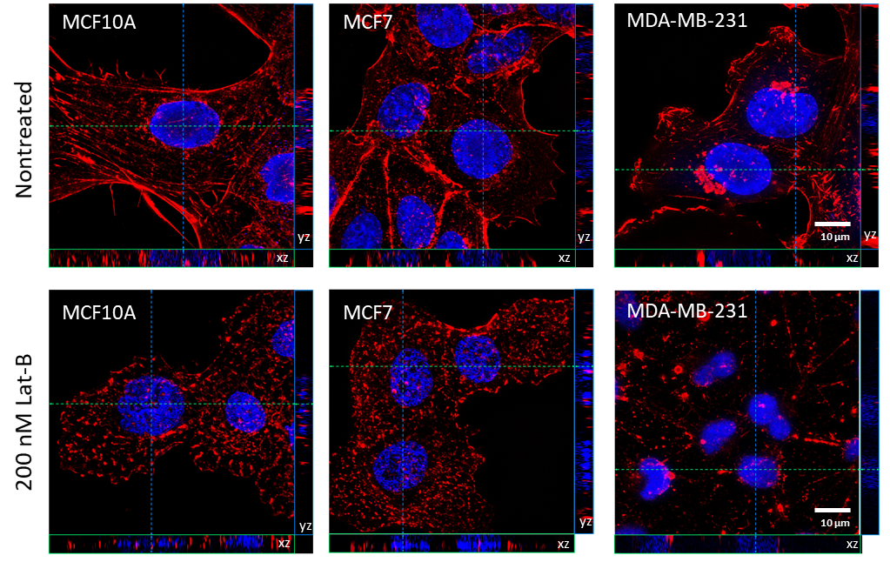
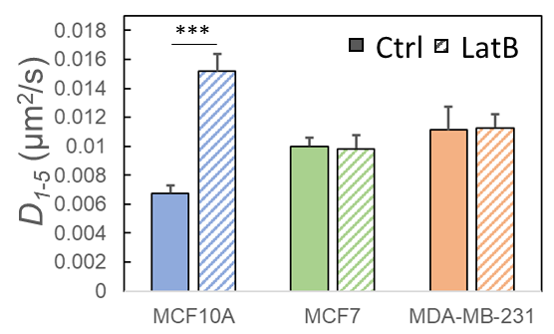
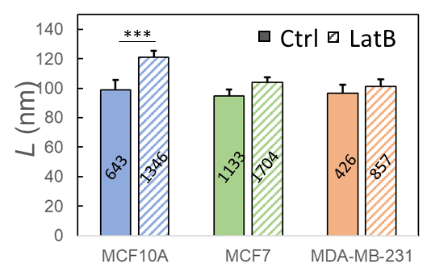
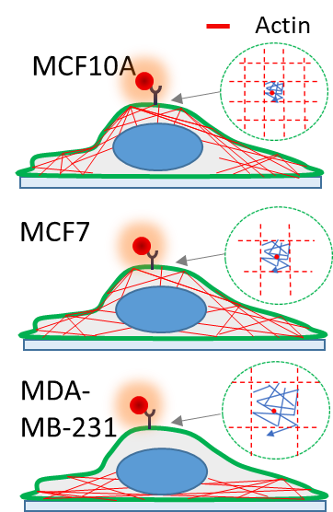
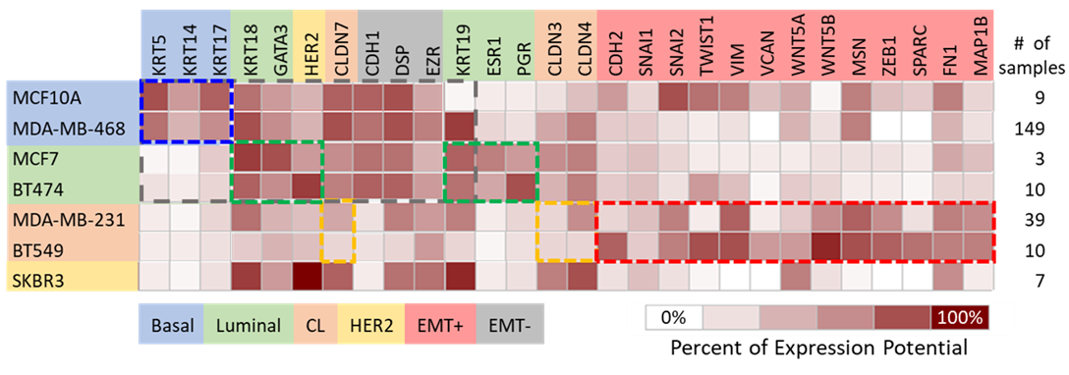




Effect of epithelial-mesenchymal transition on EGFR dynamics revealed by single-particle tracking
Yen-Liang Liu¹, Chao-Kai Chou², Yu-An Kuo¹, Mirae Kim¹, Rohan Vasisht¹, Cong Liu¹, Evan P. Perillo¹, Hannah Horng³, Mien-Chie Hung^{2,4}, Andrew K. Dunn¹, & Hsin-Chih Yeh*¹ Department of Biomedical Engineering, University of Texas at Austin, Austin, TX, USA; ²Department of Molecular and Cellular Oncology, the University of Texas MD Anderson Cancer Center, Houston, TX, USA; ³Department of Bioengineering, the University of Maryland, College Park, MD, USA.
Introduction
Effect of EMT induction on EGFR dynamics
EMT desensitizes the EGF-stimulated EGFR-phosphorylation
Whereas derailed receptor trafficking could be a hallmark of tumorigenesis and increased metastatic potential of cancers, receptor dynamics have not been used to differentiate between metastatic and non-tumorigenic cells. Using the single-particle tracking techniques, we have studied the dynamics of epidermal growth factor receptor (EGFR) in 7 breast cell lines with a variety of epithelial-mesenchymal transition (EMT) potential and shown a clear evidence that increased EGFR diffusivity and enlarged EGFR confinement size in the plasma membrane are correlated with the enhanced EMT potential in these cell lines. As often EMT promotes metastasis through cytoskeleton modifications that weaken cell-cell adhesion and facilitate cell mobility, we hypothesize that EMT can also alter receptor dynamics in the plasma membrane. Indeed, upon EMT induction, EGFR diffusivity significantly increases for MCF10A and MCF7 cells, but not for MDA-MB-231 cell which is already metastatic. Transmembrane Receptor Dynamics (TReD), as revealed by single-particle tracking, can thus serve as a new physical phenotyping method to assess metastatic potential of cancer cells.
A
B
A
B
vbSPT
C
D ↑, L ↑
C
Anti-EGFR-IgG-40 nm FN
D
EGFR
Microdomain
Cortical Actin
TReD differentiates mesenchymal cells from epithelial cells
E
EMT-induction reduces the EGF-stimulated EGFR-phosphorylation and also lowers the transition probability from free diffusion to confined diffusion.
C
EMT-induction turns epithelial-type of MCF10A and MCF7 into mesenchymal type cells.
EMT induces the re-organization of cortical actins, which might lead to the increase of EGFR diffusivity and the enlargement of microdomain.
TReD assay is compatible with microfluidic chips
A
Depolymerization of F-actin increases EGFR diffusivity
A
Structured Illumination Microscopy
B
B
D
The TReD biophysical phenotyping assay is compatible with microfluidic chips, such as the Parsortix circulating tumor cell (CTC) isolation chip.
C
D
E
The selected 7 breast cell lines represent the 5 intrinsic subtypes of breast cancer: Luminal A, Luminal B, HER2-enriched, Basal and Claudin-low.
Cells with a higher gene expression level of EMT-related genes exhibit higher EGFR diffusivity.
E
Classification biomarkers and EMT-related genes
References & Acknowledgement
1. Perillo, Evan P., et al. "Deep and high-resolution three-dimensional tracking of single particles using nonlinear and multiplexed illumination." Nature Communications 6 (2015).
2. Liu, Yen-Liang, et al. "Segmentation of 3D trajectories acquired by TSUNAMI microscope: an application to EGFR Trafficking." Biophysical Journal 111.10 (2016): 2214-2227.
This work was funded by the Texas 4000 and National Institutes of Health (CA193038).
Depolymerization of F-actin increases EGFR diffusivity, and this result supports that the increase of EGFR diffusivity is due to the EMT-induced reorganization of cortical actin.

